Slide 1
Introduction to the Production Cycle
Definition: The series of steps involved in transforming raw materials into finished goods ready for sale.

Slide 2
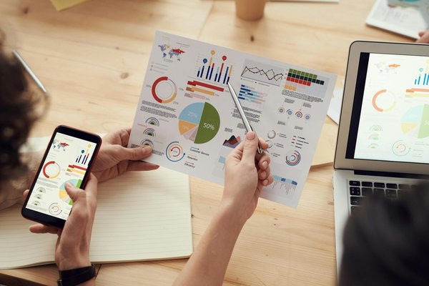
Planning Stage
Demand Forecasting: Predicting future demand for the product.
Resource Allocation: Determining the necessary resources (materials, labor, equipment).
Capacity Planning: Ensuring sufficient production capacity to meet demand.
Production Scheduling: Creating a timeline for production activities.

Slide 3
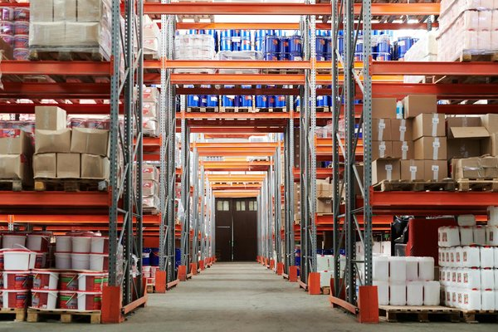
Input Stage
Raw Material Acquisition: Sourcing and procuring the necessary raw materials.
Inventory Management: Maintaining optimal levels of raw materials and work-in-progress.
Quality Control: Inspecting incoming materials to ensure they meet required standards.

Slide 4
Processing Stage
Value-Added Activities: Transforming raw materials into finished goods through various processes.
Manufacturing Operations: Utilizing machinery and labor to execute production tasks.
Work-in-Progress Monitoring: Tracking the progress of production and identifying potential bottlenecks.
```mermaid
flowchart TD
A[Raw Materials] --> B[Processing Step 1]
B --> C[Processing Step 2]
C --> D[Processing Step 3]
...

Slide 5

Output Stage
Quality Assurance: Inspecting finished goods to ensure they meet quality standards.
Packaging and Labeling: Preparing finished goods for shipment and sale.
Warehousing and Distribution: Storing and delivering finished goods to customers.

Slide 6

Evaluation Stage
Performance Measurement: Analyzing key metrics such as production efficiency, cost, and quality.
Continuous Improvement: Identifying areas for optimization and implementing changes to enhance the production cycle.
Waste Reduction: Minimizing waste throughout the production process to reduce costs and environmental impact.

